Slide 1
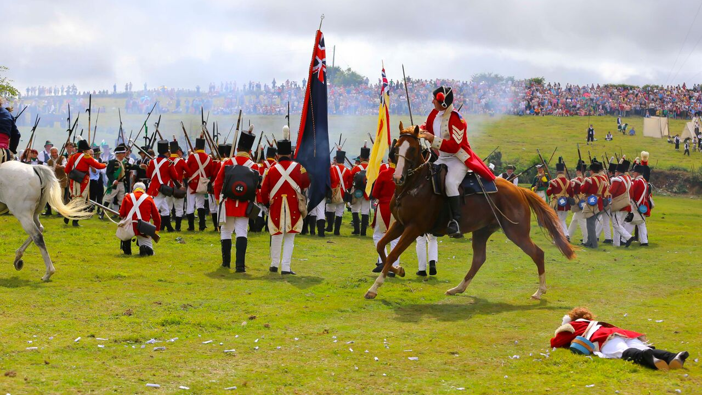
The 1798 Rebellion: An educational resource

Slide 2
Contents
Introduction
The Age of Revolution
Late Eighteenth Century Ireland
Theobald Wolfe Tone
Countdown to Rebellion
Outbreak of Rebellion
Rebellion in County Wexford
Wexford Leaders
Final Days & Aftermath
1798 Ballads, Poems & Weaponry

Slide 3
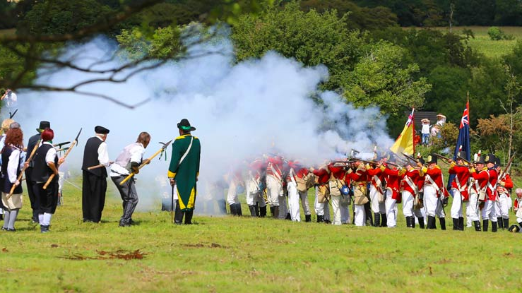
Introduction
Image from Battle of Vinegar Hill Re-enactment

Slide 4
The 1798 Rebellion was a pivotal event in Irish history. It involved members from all sections of society rebelling against English interference in Irish affairs.
The leaders of the Rebellion are remembered as the founding figures of Irish Republicanism and their vision for a union of all Irish citizens and an independent Ireland would inspire later generations of Irish revolutionaries.

Slide 5
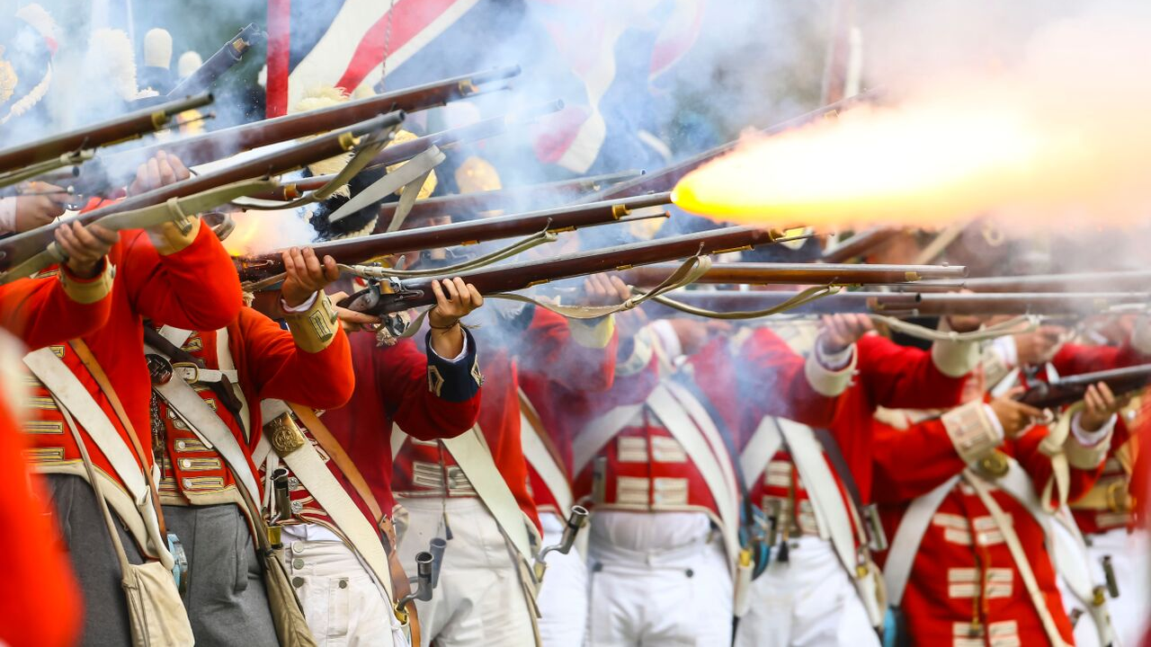
The Age of Revolution
Image from Battle of Vinegar Hill Re-enactment

Slide 6
Ireland was not the only country to stage a rebellion in the late 1700’s, many countries throughout Europe and North America saw their populations rise up against their governments for various reasons.
Revolutions took place in American 1775, France 1789, the Dutch Netherlands 1785, Hungary 1790, Poland 1791, Russia 1793 and the Austrian Netherlands in 1797.
It was the American War of Independence and the French Revolution which would have the greatest impact on political thought in Ireland in the late 18th century.

Slide 7
What inspired countries to Rebel?
One of the main reasons that led countries to rebellion was the division of wealth between the upper and lower classes.
The upper classes of society monopolised economic wealth and political power. The lower classes of society were forced to live in extreme poverty and had little influence over the laws which governed them.
The ideals of Liberty, Equality and Fraternity, introduced by enlightenment philosophers had a profound impact on the lower and middle classes, as it led them to question the way in which they were treated by the ruling classes. (1)

Slide 8
The American War of Independence
The American War of Independence occurred due to dissatisfaction amongst the American colonists with taxes imposed on the colonies by the British government.
The American War of Independence commenced at Lexington in 1775. By 1776, 13 Colonies of America, led by George Washington, were at war with the British.
Lord Cornwallis a leading British general, surrendered at Yorktown, Virginia in 1781.
American Independence from Britain was then recognised with the signing of the Treaty of Versailles in 1783. (2).

Slide 9
The French Revolution
The French Revolution broke out with the storming of the Bastille on 14 July 1789.
The main factors which influenced the French Revolution were Enlightenment Ideals, dissatisfaction with King Louis XVI and Queen Marie-Antoinette and the economic crisis which gripped the country in the 1780’s.
In 1791, a new French constitution based on the ideals of Liberty, Equality and Fraternity was introduced. In Ireland, these ideals inspired constitutional reform efforts in the early 1790’s and ultimately the 1798 Rebellion. (3)

Slide 10
Thomas Paine’s Rights of Man
The writings of the political theorist Thomas Paine also impacted on political thinking in Ireland in the 1790’s. Paine’s Rights of Man, emphasized the need for equal rights for all citizens.
In the first year following its publication over 40,000 copies of The Rights of Man were sold throughout Ireland.
In 1792, Paine was made an honorary member of the Dublin Society of United Irishmen. This is testament to the influence of Thomas Paine’s political writings on the Society of United Irishmen. (4)

Slide 11
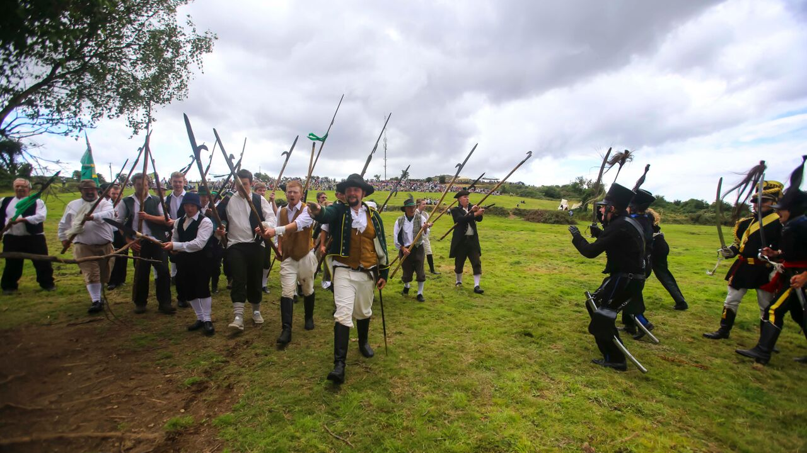
Late Eighteenth Century Ireland
Image from Battle of Vinegar Hill Re-enactment

Slide 12
Political Power & Landownership in Ireland
In the late 18th century there were 150 constituencies represented in the Irish House of Commons and over half of these constituencies were dominated by individuals or small groups of wealthy landowners.(5)
Catholics were excluded from voting rights until 1793 and were excluded from holding seats in parliament until 1829. Presbyterians, while not excluded from parliament, were under-represented.
In the 1780’s a campaign for parliamentary reform was launched. The aim of the campaign was to grant a greater majority of citizens’ voting rights and seats in parliament. However, reform proposals were rejected by the Irish parliament. (6)

Slide 13
Over the course of the 18th century agriculture prospered and new industries emerged. Ireland also experienced rapid population growth during the 18th century. This increased population growth and economic prosperity led to increased demands for land. (7)
The vast majority of land in late 18th century Ireland was owned by Protestant landowners. In the previous century, vast amounts of land were confiscated from Catholic and Presbyterian landowners during the Cromwellian and Williamite land settlements.
Members of the Ireland’s Protestant Ascendancy were also critical of English interference in Irish political affairs in the late 18th century.

Slide 14
The Founding of the Society of United Irishmen
Inspired by the ideals of the Enlightenment and the successful revolutions in France and America, the Society of the United Irishmen was founded in Belfast in October 1791. (8)
Some of its founding members included Samuel Neilson, Thomas Russell, James ‘Napper’ Tandy and Theobald Wolfe Tone. Its founders believed that social and political change were required in Ireland.
The Society of United Irishmen aimed to remedy the situation in Ireland by ensuring that each citizen was represented in parliament. Once this had been achieved, a campaign for a reduction of English influence in Irish affairs would commence. (9)

Slide 15
James ‘Napper’ Tandy
By Charles Joseph Hullmandel & Catherine Sampson Tone.
Image courtesy of the National Library of Ireland

Slide 16
French Symbols Adopted by the United Irishmen
The Tree of Liberty was a symbol of the successful revolution in France. In Ireland, liberty trees were planted throughout the country in the 1790’s. (10) The Society of United Irishmen also adopted a catechism surrounding the Tree of Liberty.
What is that in your hand?
-- It is a branch
Of What?
-- Of the Tree of Liberty
Where did it first grow?
-- In America
Where does it bloom?
-- In France
Where did the seed fall?
-- In Ireland.

Slide 17
The United Irish Patriots of 1798
Image courtesy of the National Library of Ireland

Slide 18
The Suppression of the Society of United Irishmen
When war broke out between England and France in 1793, the English government utilised a policy of appeasement and repression in Ireland.
The Catholic Relief Act was passed, it granted Catholic landowners voting rights but did not encompass the full Catholic emancipation which campaigners had hoped for.
Fears of a possible alliance between the Society of United Irishmen and the French led to the introduction of the Gunpowder Act, Militia Act and Convention Act in 1793. These acts combined with the imprisonment of several leading members of the United Irishmen, led their leaders to believe that further reform efforts were futile. (11)

Slide 19
In 1794, Wolfe Tone expressed his belief that a French invasion would be welcomed in Ireland:
From reason, reflection, interest, prejudice, the spirit of change, and the misery of the great bulk of the nation […] there seems little doubt, but an invasion in sufficient force would be supported by the people. (12)
This statement provides evidence of the transformation from a reform movement to a revolutionary body, which the Society of United Irishmen was undergoing.
Hopes that greater rights would be granted to Catholics or reform of parliament would take place were dashed when Lord Fitzwilliam was recalled from his role as Lord Lieutenant, in February 1795. This led to the radicalisation of many reformers. (13)

Slide 20
The Society of United Irishmen underwent a significant organisational transformation in 1795. A new constitution was drafted, they became a secret oath bound society, more radical members were recruited, and preparations commenced for an armed uprising.
In the same year Wolfe Tone travelled to America with the aim of contacting the French and securing assistance to stage a rebellion in Ireland. (14)

Slide 21
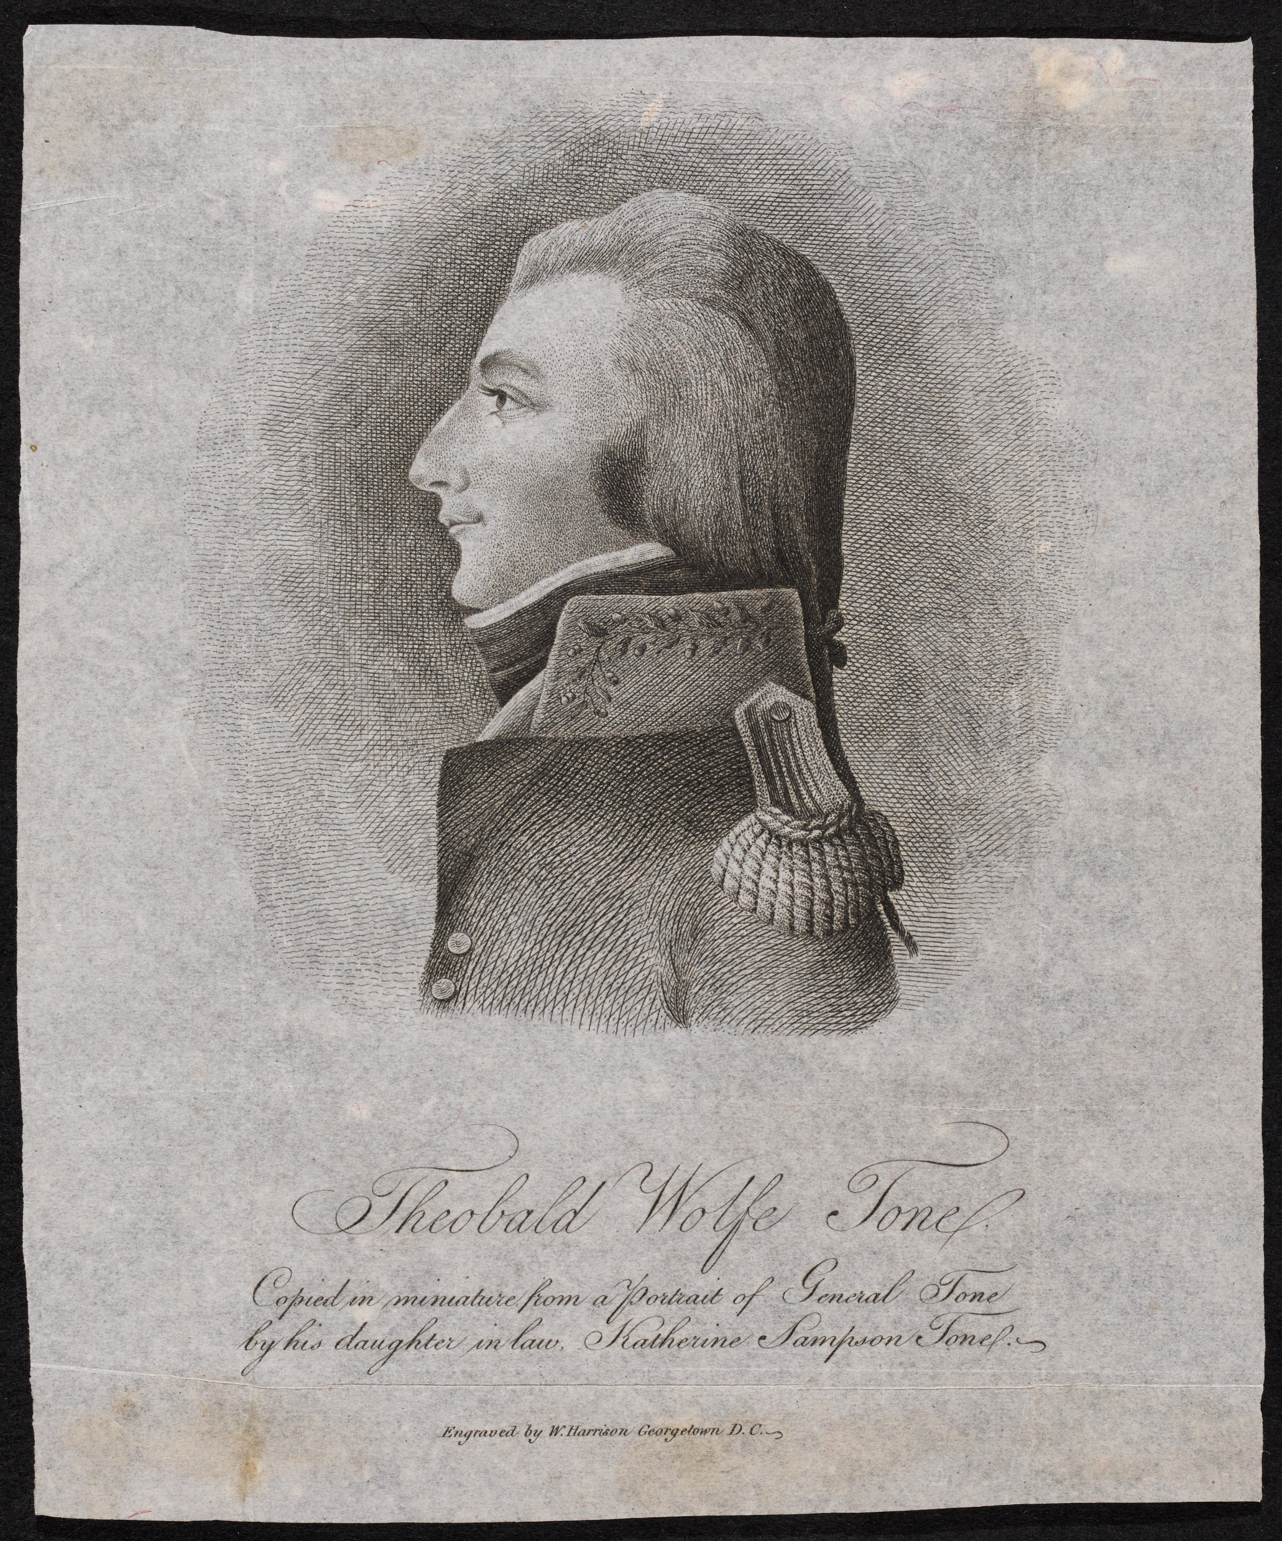
Theobald Wolfe Tone by William Harrison
Image courtesy of the National Library of Ireland

Slide 22
Theobald Wolfe Tone was born in Dublin, in June 1763, into a middle-class family.
Tone entered Trinity College in 1781. He soon became involved in politics through the Whig party and began to turn his attentions to political writing. During parliamentary debates in 1790, Tone befriended Thomas Russell. (15)
In July 1791, Russell requested that Tone compile a set of resolutions to commemorate the fall of the Bastille. When the Society of United Irishmen was founded in Belfast in October 1791, its declaration and resolutions were based on Tone’s resolutions. (16)

Slide 23
In the early 1790’s Tone continued to write on behalf of the Society of United Irishmen, however his main focus at this time was the political rights of Catholics. (17)
Tone was bitterly disappointed with the results of the Catholic Relief Act of 1793.
In 1794, Tone became involved with the French agent William Jackson. Tone wrote a ‘Memorandum on the situation of Ireland’ in which he presented his belief that a French invasion would be welcomed if France did not attempt to conquest Ireland. (18)

Slide 24
To avoid imprisonment Tone was forced to leave Ireland for America in June 1795. Tone departed for America with the intention of securing French assistance to end English influence in Irish affairs.
In America, Tone approached the French Minister Pierre Adet, and he informed Adet of his plan to go to France to negotiate a French intervention in Ireland. Tone left America for France in January 1796.
However, the first attempt at a French invasion ended in disaster, when a storm hit the French fleet. (19)
In September 1798, Tone sailed to Ireland as part of a French invading force. Tone was captured off the coast of Donegal, on 12 October, tried and sentenced to death.

Slide 25
Tone’s Interview with Napoleon 1797 by J.F. O’Hea
Image courtesy of the National Library of Ireland

Slide 26
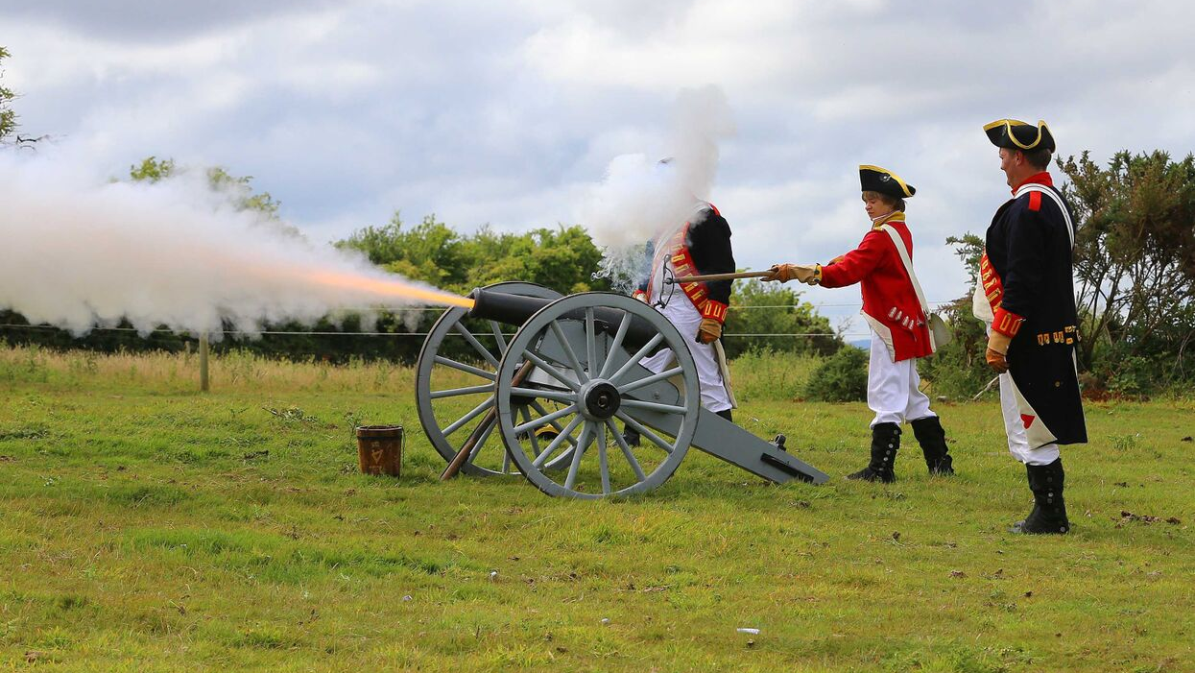
Countdown to Rebellion
Image from Battle of Vinegar Hill Re-enactment

Slide 27
The Failed French Landing
On 16 December 1796, a fleet of over 35 ships carrying 12,000 armed French troops set sail for Bantry Bay. The French troops were led by General Lazare Hoche.
Hoche’s ship was swept off course when trying to avoid the English navy and while the rest of the fleet waited for his arrival outside Bantry Bay, they were hit by a terrible storm.
This storm destroyed many of the French ships and following the storm, the remainder of the French fleet set sail back to France.
This was a major setback for the United Irishmen. However, they continued to pursue their plan for an armed uprising. (20)

Slide 28
Government Clampdown
Aware of the threat posed by a possible alliance between the United Irishmen and the French, government put in place a number of measures to ensure order was maintained and any potential threat curtailed.
In 1796, they established a new force of part-time soldiers known as Yeomen. The function of the Yeomanry was to police their local areas and provide support to regular troops.
The Insurrection Act passed in 1796, allowed for the implementation of martial law in areas where the threat of an uprising existed. (21)

Slide 29
Between October 1796 and May 1797, the membership of the United Irishmen in Ulster increased from 38,567 to 117,917. (22)
In 1797, Martial law was declared in Ulster, weapons searches were carried out and members of the United Irishmen were arrested and imprisoned.(23)
In the spring of 1798, Ireland was declared be in a state of rebellion and widespread implementation of Martial Law ensued.
Yeomanry and Militia units were dispatched across the country in an effort to clamp down on the United Irishmen. They were instructed to reveal their members and seize their weapons.

Slide 30
Captn. Swayne pitch-capping the people of Prosperous, Co. Kildare. by Henry Brocas
Image courtesy of the National Library of Ireland

Slide 31
Various torture techniques were implemented to extract information from those believed to be supporters or members of the United Irishmen.
Pitchcapping was one of the worst torture methods carried out. Pitchcapping involved pouring hot tar into a half circular cap. The cap was then upturned and pressed down on a victim’s head. Once the tar had cooled, the pitch cap was pulled off, along with a victim’s hair and scalp. (24)
Members of the Militia and Yeomanry burned homes, killed livestock and destroyed crops. Lord Cornwallis, Commander-in-Chief and Viceroy of the Crown forces in Ireland during 1798, wrote about their ill-discipline. Cornwallis stated;
The Irish militia are totally without discipline, contemptible before the enemy when any serious resistance is made to them, but ferocious and cruel in the extreme when any poor wretches either with or without arms come within their power; in short murder appears to be their favourite pastime. (25)

Slide 32
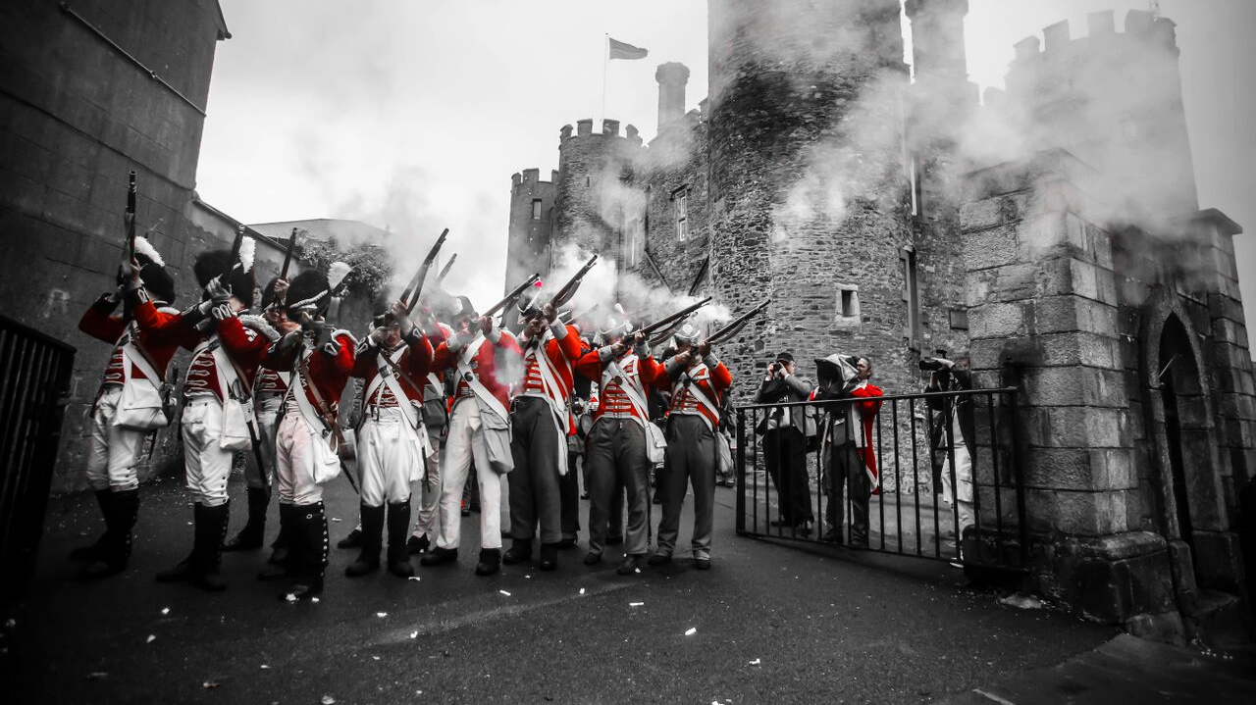
Outbreak of Rebellion
Image from Battle of Enniscorthy Re-enactment

Slide 33
Rebellion in Dublin & surrounding counties
The United Irishmen’s plan was to seize Dublin on 23 May and simultaneously United Irishmen in the counties of Meath, Kildare, Wicklow and Carlow were to engage the Crown Forces in their given county to prevent military reinforcements from entering Dublin.
In Dublin, the United Irishmen planned to occupy key public buildings, such as Dublin Castle. Mail coaches would be stopped as a signal to the United Irishmen in other counties that the rebellion had commenced.
The intelligence available to the Crown Forces enabled them to intercept the United Irishmen and as a result the Rebellion in Dublin was a failure. (26)

Slide 34
Uprisings in counties surrounding Dublin were also unsuccessful.
In County Kildare, the Rebels took the town of Prosperous and the village of Kilcullen before suffering defeats at the hands of the Crown Forces at Nass and Clane.
In County Wicklow, the Rebels attempted unsuccessfully to capture the towns of Dunlavin and Baltinglass.
In County Meath, the Rebels lost several hundred men when their camp at Tara Hill was attacked. (27)

Slide 35
Rebellion in Ulster
The Rebellion broke out in Antrim on 7 June. The Rebels under the leadership of Henry Joy McCracken captured the towns of Ballymena and Randalstown.
However, after these initial successes the Rebels suffered a heavy defeat when they attempted to seize Antrim town.
On 9 June, Rebels in County Down mobilised. They took the town of Saintfield and later they successfully captured Newtownards and Ballynahinch.
The Rebels in County Down were eventually defeated at Ballynahinch. (28)

Slide 36
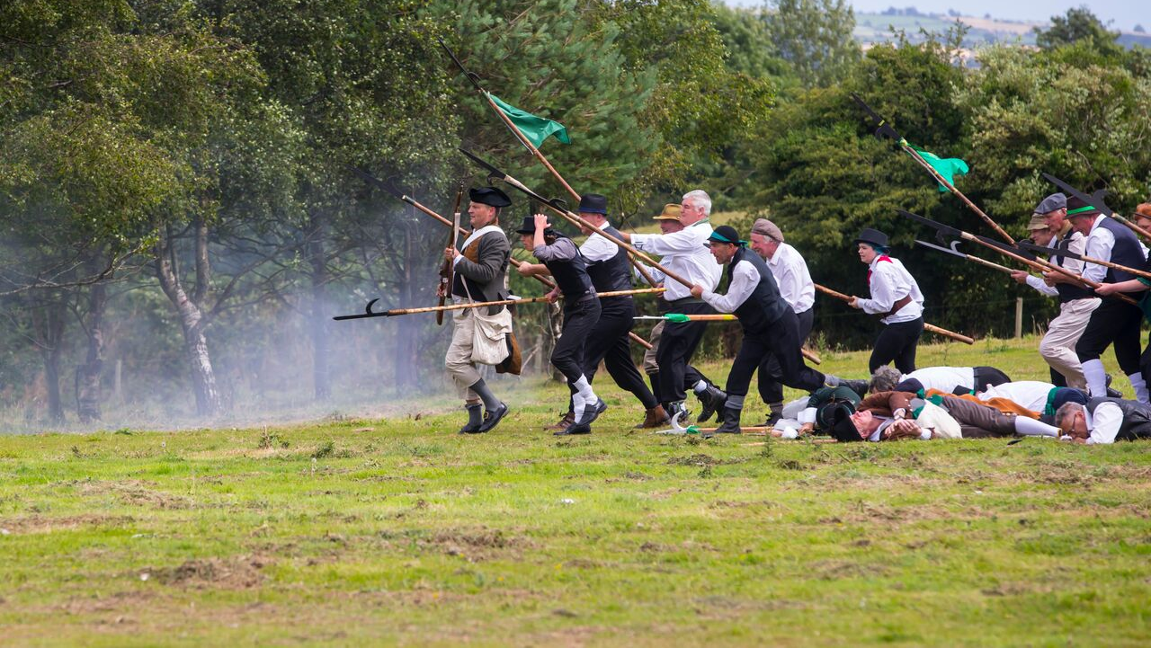
Rebellion in Wexford
Image from Battle of Vinegar Hill Re-enactment

Slide 37
Skirmish at the Harrow
By 26 May 1798, news of the Rebellion waging in Dublin, Meath and Kildare began to filter into Co. Wexford.
On this day, Yeomen Cavalry led by Lieutenant Bookey, rode to a dwelling of a suspected United Irishman in Boolavogue. Finding their target was not at home, they set fire to the cabin.
They were later ambushed by Fr. John Murphy and his men, which led to the deaths of Lieutenant Bookey and Private John Donovan. (29)

Slide 38
Battle of Oulart Hill 1798 by E. Foran
Image courtesy of the National Library of Ireland

Slide 39
Battle of Oulart Hill
Following the skirmish at the Harrow, Fr. John Murphy and his men were joined by hundreds of Rebels who had made their way towards Oulart Hill.
When news of the skirmish at the Harrow reached the Crown Forces in Wexford town, the majority of its garrison, 110 North Cork Militia were ordered to crush the Rebellion.
On 27 May, the Militia reached Oulart and began to advance upon the 2000 rebels on Oulart Hill. Upon firing a number of unsuccessful volleys which failed to break the rebel lines, the Rebels themselves launched a major pike charge, which annihilated the Militia leaving only five survivors. (30)

Slide 40
Battle of Enniscorthy
Following their victory at Oulart, the Rebel forces made their way towards Enniscorthy on 28 May.
After several hours of intense fighting, the Rebels succeeded in capturing Enniscorthy Town, they then set up their main camp on Vinegar Hill. (31)
Over the course of the next 24 hours, Rebel leaders from the local parishes gathered their forces and made their way to the encampment on Vinegar Hill, considerably bolstering the rebel numbers.

Slide 41
Battle of Three Rocks
After their success at Enniscorthy, a decision was reached to march on the garrison at Wexford town. A force of up to 10,000 Rebels left Vinegar Hill and set up camp at Forth Mountain before attacking Wexford Town. (32)
The Rebels sprang an ambush on government re-enforcements at the Battle of Three Rocks. After hearing of the ambush, the garrison of Crown Forces abandoned Wexford town.(33)
The Rebel leaders then decided to divide their forces into two attacking groups, commonly referred to as the North Division and the South Division. The South Division headed for New Ross. While the North Division headed for the towns of Bunclody, Gorey & Arklow. (34)

Slide 42
Battle of New Ross
The Battle of New Ross commenced at dawn on 5 June. Crown Forces, expecting the Rebel assault, had prepared defences in advance. They had a compliment of 2,000 soldiers under the command of General Johnson. Bagenal Harvey led approximately 10,000 Rebels.
Initial Rebel success occurred under John Kelly, his men succeeded in seizing two-thirds of the town.
However, in the early afternoon the Crown Forces rallied, and re-took all of New Ross. The Rebels withdrew having sustained approximately 2,500 casualties. The Crown Forces lost approximately 250 personnel. (35)

Slide 43
Battle of Newtownbarry
On 1 June, the Battle of Newtownbarry (now Bunclody) took place.
Positioning an artillery piece aimed at Yeomanry on the outskirts of the town, the Rebels pushed the Crown Forces back into the town. Pikemen then drove the majority of the enemy across the bridge into Co.Carlow.
However, British sharpshooters still within the confines of Newtownbarry caused havoc amongst the Rebels and upon hearing the gunfire, the main force of the Redcoats returned, inflicting 400 deaths on the Rebels and leading to their withdrawal. (36)

Slide 44
The Battle of Arklow
On 9 June, Rebel forces commenced their assault on Arklow, Co. Wicklow.
They opened with cannon fire from various strategic points around the outskirts of the town. Crown Forces returned artillery fire from the fortified barricades they had constructed at all the main entry points to the town.
The Rebel forces bravely moved towards them. However, they were pushed back at all locations. The Rebels were defeated and withdrew at nightfall. (37)

Slide 45
The Battle of Foulksmills
On 19 June, Sir. John Moore led his forces out of New Ross with the intention of linking up with the garrison at Duncannon. The plan to link up with the Duncannon garrison did not materialise and Moore’s troops headed for the village of Taghmon.
Upon nearing Goff’s Bridge at Foulkesmills, Moore was informed that Rebel forces under the leadership of Fr. Philip Roche were heading towards them.
Moore’s troops managed to hold their lines until reinforcements arrived. When reinforcements arrived, the Crown Forces overcame the threat posed by the Rebels. (38)

Slide 46
Vinegar Hill, Charge of the 5th Dragoon Guards on the Insurgents by William Sadler
Image courtesy of the National Library of Ireland

Slide 47
The Battle of Vinegar Hill
When the Rebellion was successfully defeated in Ulster, General Lake, Commander in Chief of the Crown Forces, turned his attention to ending the Rebellion in Wexford.
The Battle of Vinegar Hill took place on 21 June. General Lake ordered his forces to surround the Rebels on all sides of Vinegar Hill to prevent any escape.
However, there was a flaw in General Lake’s plan. General Needham who was instructed to position his troops on the southern slope of Vinegar Hill, had not arrived by the time the battle commenced. (39)

Slide 48
On the morning of 21 June, there were approximately 10,000 Crown Forces in position. The Crown Forces were well armed with cannons and muskets, in comparison to the Rebels who had meagre weapons such as pikes.
In the weeks leading up to the Battle of Vinegar Hill, the Rebels had made no attempt to make the hill a formidable defensive position. (40)
Myles Byrne one of the youngest rebel leaders who fought at Vinegar Hill gives the following account;
I had not seen Vinegar Hill since the morning after the Battle of Newtownbarry, the 2nd. of June, and I was surprised to find that scarcely anything had been done to make it formidable against the enemy; the vast fences and ditches which surrounded it on three sides, and which should have been levelled to the ground, for at least a cannon shot, or half a mile’s distance, were all left untouched. (41)

Slide 49
On June 21, at 3 am the battle commenced. General Johnson commenced artillery bombardment on the Rebel positions on the outskirts of Enniscorthy town, while General Lake commenced artillery bombardment of the Rebel positions on Vinegar Hill.
At 7 am, Lake’s forces commenced infantry assault on the Rebels on Vinegar Hill. By this time, the Rebels based in the town had pulled back over Enniscorthy Bridge and a stalemate ensued.
By 9 am, the Rebel leaders believed that their defence of Vinegar Hill was futile without reinforcements from Wexford town. They made the decision to retreat towards Wexford town.

Slide 50
As the Rebels retreated towards Wexford they encountered General Needham and his troops.
Needham pursued the Rebels and had it not been for the arrival of re-enforcements from Wexford town, under the leadership of Edward Roche, the retreating Rebels would have suffered significant casualties. Roche’s forces engaged with Needham and his troops, until Needham gave up his pursuit of the retreating Rebels. (42)
It is estimated that 1,500 hundred lives were lost during the Battle of Vinegar Hill, the majority of these were women and children who had been taking shelter in the Rebel camp. (43)

Slide 51
After being defeated at Vinegar Hill the Rebels regrouped at Wexford Town. Some of their leaders went into hiding, for example Bagenal Harvey went to the Saltee Islands. Others such as Thomas Cloney and Edward Hay attempted to negotiate a surrender.
When General Lake offered no terms of surrender, Rebel leaders Anthony Perry, Myles Byrne, Father John Murphy and Edward Roche, left Wexford. Meanwhile, General Lake and his forces were rounding up and executing suspected Rebel leaders. (44)

Slide 52
Rebels led by Fr. John Murphy and Myles Byrne headed for Killedmond, Carlow where they defeated government forces. Later Father Murphy and his bodyguard James Gallagher were captured and sentenced to death in Tullow, Co. Carlow. (45)
Rebel forces under the leadership of Edward Roche and Anthony Perry, headed for County Wicklow, onto Meath and then south again to Dublin, fighting skirmishes along the way.
The last major clash was at Ballyboghill, in North Dublin, where the Rebels were defeated by General Gordon’s forces. (46)

Slide 53
Wexford Leaders

Slide 54
Myles Byrne
Born in Ballylusk, Monaseed, Co. Wexford in 1780. He joined the United Irishmen in 1797.
Byrne participated in the Rebellion at Bunclody, Tubberneering, Arklow and Vinegar Hill. Accompanied Fr. John Murphy on the advance to and retreat from Castlecomer, Co. Kilkenny. Byrne continued in the field until the end, eventually escaping to Dublin where he remained undetected. (47)
After the failure of Robert Emmet’s Rising in 1803, Byrne escaped to Paris. Byrne was commissioned as an infantry officer in the Irish Legion. Fought in the Napoleonic wars where he had a distinguished career. Died in Paris in 1862.(48)

Slide 55
Fr. John Murphy
Studied for the priesthood in Spain and returned to Ireland in 1785 and became curate at Boolavogue.
Many people had to leave their homes to avoid persecution by the Yeomanry. This is believed to have driven Fr. Murphy to join the Rebellion.
On 27 May, Fr. Murphy led a large group of pikemen and defeated a party of government troops at Oulart. The next day he took Camolin, followed by Enniscorthy and encamped on Vinegar Hill.
After defeats at Arklow and Vinegar Hill, Fr. Murphy joined a rebel group that fought small battles and skirmishes in Counties Carlow and Kilkenny. On 2 July, Fr. Murphy was arrested and executed along with James Gallagher in Tullow, Co. Carlow. (49)

Slide 56
Rev. John Murphy, PP of Monageer and Boolavogue by James Dergan
Image courtesy of the National Library of Ireland

Slide 57
John Kelly ‘of Killanne’
Best remembered in the ballad by P. J. McCall, ‘Kelly the Boy from Killanne’. He served in the Rebel army for approximately one week and fought twice.
On 29 May after the battle at Enniscorthy, Kelly and other men from Killanne joined the Rebel camp at Vinegar Hill.
Kelly fought and was badly wounded at the Battle of New Ross. He was then brought to Wexford. He remained there until General Lake entered the town. Following this he was tried by court martial and sentenced to death.

Slide 58
Bagenal Harvey
Harvey, was arrested on 26 May and held in Wexford Gaol. Harvey remained in Wexford until it was occupied by the Rebels and he was freed. He was then appointed Commander-in-Chief of the Rebel forces in County Wexford. (50)
Harvey was in command at the Battle of New Ross. On 7 June, he was replaced as Commander-in-Chief by Fr. Philip Roche. He returned to Wexford, where he was appointed President of the town committee.
Following the Rebels’ defeat at Vinegar Hill, Harvey made his way to a cave on the Saltee Islands. From there he planned to escape to France by sea. However, he was found, arrested and brought back to Wexford, where he was sentenced to death on 28 June 1798. (51)

Slide 59
Fr. Michael Murphy
Fr. Michael Murphy was born at Kilnew, County Wexford and educated at a hedge school in Oulart. He was ordained at Wexford in 1785 and the following autumn he left Ireland for France.
Upon return from France, he became parish priest of Ballycanew. It is believed that he joined the Rebellion when his church was ransacked by the Yeomanry on 27 May. He travelled to Gorey and then to Kilthomas Hill and was joined by Fr. John Murphy on Ballyorril Hill.
Fr. Michael Murphy was killed at the Battle of Arklow, on 9 June 1798. (52)

Slide 60
Thomas Cloney
Son of Denis Cloney, a farmer from Moneyhore, Co. Wexford. He later claimed that he was not a United Irishman and had been forced to join the Rebels against his will. He played a leading role in the Battle of Three Rocks and also participated in the Battle of New Ross.
Following the Rebels’ defeat, he went into hiding. In June 1799, Cloney was arrested, court-martialled, found guilty and sentenced to death. His sentence was reduced to two years in exile.
He returned to Ireland in February 1803. He died on 20 February 1850 at the age of seventy-six. (53)
He was author of the book, ‘A Personal Narrative 1798’, published in 1832.(54)

Slide 61
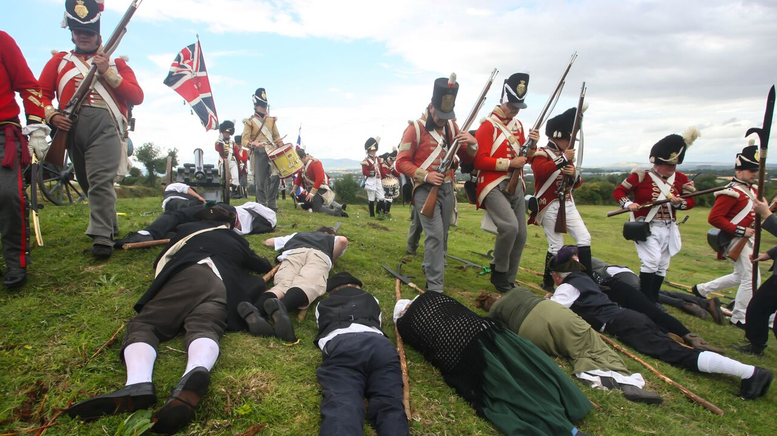
The French Landing & Aftermath of Rebellion
Image from Battle of Vinegar Hill Re-enactment

Slide 62
French Landing at Killala
In August 1798, French troops under the command of General Humbert, joined with United Irishmen in Connaught and proceeded to fight a number of battles and skirmishes. They won some important victories at Ballina and Castlebar. (55)
General Humbert and his troops were eventually defeated at the Battle of Ballinamuck, Co. Longford on 8 September.
The French surrendered to the Crown Forces and were made prisoners of war, while many of the captured Rebels were sentenced to death. (56)

Slide 63
Aftermath of the 1798 Rebellion
Over 30,000 lives were lost throughout Ireland as a result of the 1798 Rebellion.
The Rebellion also resulted in widespread destruction of property, numerous homes and churches burned and farmland destroyed.
The 1798 Rebellion led to the passage of the Act of Union in 1800. The Act of Union meant that Ireland would be directly ruled from the London parliament and the Irish House of Commons dissolved.
Although the 1798 Rebellion failed to achieve its aim of ending English interference in Irish affairs, it did serve as an inspiration to future generations of revolutionaries.
Sources
Barlett, Thomas, Theobald Wolfe Tone (Dublin: Historical Association of Ireland, 1997)
Barlett Thomas, David Dickson, Daire Keogh & Kevin Whelan, eds, 1798 A Bicentenary Perspective (Dublin: Four Courts Press, 2003)
Cloney, Thomas, A personal narrative of those transactions in the county Wexford, in which the author was engaged, during the awful period of 1798 (1832)
Dickson, David, Daire Keogh & Kevin Whelan, eds, The United Irishmen: Republicanism, Radicalism and Rebellion (Dublin: The Lilliput Press, 1994)
Elliott, Marianne, Wolfe Tone (Liverpool: Liverpool University Press, 2012)
Furlong, Nicholas, Fr. John Murphy of Boolavogue 1753-1798 (Dublin: Geographic Publications, 2001)
Gahan, Daniel J., Rebellion! Ireland in 1798 (Dublin: O’Brien Press, 1998)
---------------------, The People’s Rising: Wexford 1798 (Dublin: Gill & MacMillan, 1995)
Jackson, Alvin, Ireland 1798-1998 War, Peace and Beyond, 2nd edn (Oxford: Wiley-Blackwell, 2010)
Joyce, John, General Thomas Cloney: a Wexford rebel of 1798 (Geographical Publications, 1988).
Merriman, John, A History of Modern Europe (London: W.W. Norton & Co, 2004)
Moody, T.W., R.B. McDowell, & C.J. Woods, eds, The Writings of Theobald Wolfe Tone, 1763-98, 3 vols (Oxford: Oxford University Press, 2009), I
----------------------------------------------------, eds, The Writings of Theobald Wolfe Tone, 1763-98, 3 vols (Oxford: Oxford University Press, 2009), II
Moody, T.W., & F.X. Martin, The Course of Irish History (Dublin: Mercier Press, 2001)
Murphy, James H., Ireland, A Social, Cultural and Literary History 1791-1891 (Dublin: Four Courts Press, 2003)
Patterson, James G., In the Wake of the Great Rebellion (Manchester: Manchester University Press, 2008)
Pearse, Patrick, The Coming Revolution: The Political Writings and Speeches of Patrick Pearse (Cork: Mercier Press, 2012)
Poirteir, Cathal, ed., The Great Rebellion of 1798 (Cork: Mercier Press, 1998)
Dictionary of Irish Biography: Http://www.dib.cambridge.org/
Library Ireland: Http://www.libraryireland.com/

Slide 64
Robert Emmett’s Rebellion in 1803, came about as a direct result of the 1798 Rebellion.
In the aftermath of the Rebellion, Robert left Ireland for France. In 1802, he held discussions with Napoleon Bonaparte, however Napoleon wished to invade England directly.
Emmett retuned to Ireland and began preparing for an uprising in Dublin. An explosion at an arms depot forced him to stage his rebellion prematurely on 23 July 1803.
Emmett’s Rebellion amounted to little more than a street skirmish in Dublin and was easily defeated. Emmet was captured, convicted of treason and sentenced to death. (57)

Slide 65
Robert Emmet by William Read
Image courtesy of the National Library of Ireland

Slide 66
The participants in the Young Irelander uprising in 1848, the 1916 Rising and the Irish War of Independence also drew inspiration from the ideals of the 1798 Rebellion.
1916 Rising leader Patrick Pearse, credited the leaders of the 1798 Rebellion with providing Irish people with ‘a clear, precise and worthy concept of Nationality’. (58) Pearse’s words are testament to the impact of the 1798 Rebellion on later generations of revolutionaries.

Slide 67
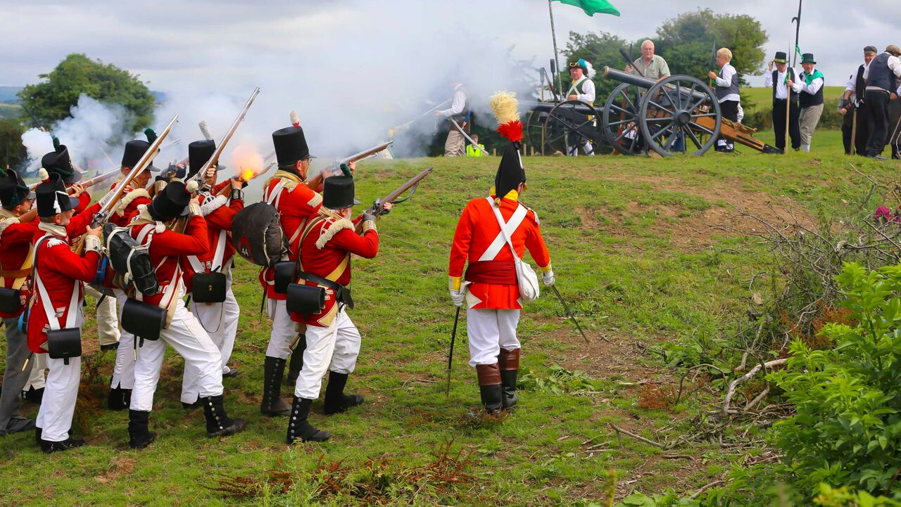
1798 Ballads, Poems & Weaponry
Image from Battle of Vinegar Hill Re-enactment

Slide 68
Ballads & Poems
The 1798 Rebellion inspired many ballads and poems. Among the most famous ballads are ‘At Boolavogue’ and ‘Kelly from Killanne’, both composed by P. J. McCall. Both ballads were composed in the late 1890’s to commemorate the one hundredth anniversary of the 1798 Rebellion. (59)
The acclaimed poet Seamus Heaney composed ‘Requiem for the Croppies’, in honour of the Rebels. Heaney wrote ‘Requiem for the Croppies’ in 1966, the fiftieth anniversary of the 1916 Rising.

Slide 69
Seamus Heaney -
Requiem for the croppies
The pockets of
our greatcoats full of barley...
No kitchens on the run, no striking camp...
We moved quick and sudden in our own country.
The priest lay behind ditches with the tramp.
A people hardly marching... on the hike...
We found new tactics happening each day:
We'd cut through reins and rider with the pike
And stampede cattle into infantry,
Then retreat through hedges where cavalry must be thrown.
Until... on Vinegar Hill... the final conclave.
Terraced thousands died, shaking scythes at cannon.
The hillside bl
ushed, soaked in our broken wave.
They buried us without shroud or coffin
And in August... the barley grew up out of our grave.

Slide 70
‘At Boolavogue’ – P.J. McCall
At Boolavogue as the sun was setting
O’er the bright May meadows of Shelmalier,
A rebel hand set the heather blazing
And brought the neighbours from far and near.
Then Father Murphy, from old Kilcormack,
Spurred up the rocks with a warning cry,
“Arm, Arm!” he cried, “for I’ve come to lead you,
For Ireland’s freedom we’ll fight or die.”
He led us on ’against the coming soldiers,
And the cowardly Yeomen we put to flight;
’Twas at the Harrow the boys of Wexford
Showed Bookey’s regiment how men could fight.
Look out for hirelings, King George of England,
Search every kingdom where breathes a slave.
For Father Murphy from the County Wexford
Sweeps o’er the land like a mighty wave.
We took Camolin and Enniscorthy,
And Wexford storming drove out our foes;
‘Twas at Sliabh Coillte our pikes were
reeking with crimson stream of the beaten Yeos.
At Tubberneering and Ballyellis
Full many a Hessian lay in his gore,
Ah, Father Murphy, had aid come over
The green flag floated from shore to shore!
At Vinegar Hill, o’er the pleasant Slaney,
Our heroes vainly stood back to back,
And the Yeos at Tullow took Father Murphy
And burned his body upon the rack.
God grant you glory, brave Father Murphy,
And open heaven to all your men;
The cause that called you may call to-morrow
In another fight for the Green again.

Slide 71
‘Kelly the boy from Killane’
What’s the news, what’s the news oh my bold Shelmalier
With your long barrelled guns from the sea
Say what wind from the south brings a messenger here
With the hymn of the dawn for the free
Goodly news, goodly news do I bring youth of Forth
Goodly news shall you hear Bargy man
For the boys march at dawn from the south to the north
Led by Kelly the boy from Killane
Tell me who is that giant with the gold curling hair
He who rides at the head of your band
Seven feet is his height with some inches to spare
And he looks like a king in command
Ah my boys that’s the pride of the bold Shelmaliers
‘Mongst greatest of hero’s a man
Fling your beavers aloft and give three ringing cheers.
For John Kelly the boy from Killane
Enniscorthys in flames and old Wexford is won
And tomorrow the Barrow we will cross
On a hill o’er the town we have planted a gun
That will batter the gateway to Ross
All the Forth men and Bargy men will march o’er the heath
With brave Harvey to lead in the van
But the foremost of all in that grim gap of death
Will be Kelly the boy from Killane
But the gold sun of freedom grew darkened at Ross
And it set by the Slaney’s red waves
And poor Wexford stripped naked, hung high on a cross
For the cause of long down trodden man
Glory-o to Mount Leinster’s own darling and pride
Dauntless Kelly the boy from Killane.

Slide 72
Weaponry
The Crown Forces
Flintlock Musket:
The Flintlock Musket was the primary standard infantry weapon of rank and file soldiers. Commonly known at the time as the 'Brown Bess,' this weapon fired a one-ounce musket ball up to 200 metres. Soldiers were trained to the standard of loading each shot and firing 3 musket balls every 60 seconds. Bayonets were often fixed to muskets for hand-to-hand combat.
Cannon Balls:
The most common cannon ball propelled by the British during the Rebellion was the 6-Pounder. They also had 2-Pounders and 4-Pounders in use during the Rebellion.

Slide 73
Society of United Irishmen
Flintlock Musket:
The Rebels attained large numbers of Flintlock Muskets during the 1798 Rebellion. These were primarily captured in battle from dead and injured members of the Crown Forces.
The Pike:
Used by the Rebels, it was originally made of ash wood but as oak was far more abundant in the Irish countryside, this became its chief source allied with the metal attached to the wood, made by Rebel blacksmiths.
The pike had a hook near its top which was used to grab the reins of British Cavalry horses, thereby pulling down both horse and rider.

Slide 74
The Men of ’98 Wolfe Tone, Michael Dwyer, William Orr, Ld. Edward Fitzgerald, A. Hamilton Rowan, Thomas A. Emmet, Death of Father Michael Murphy at Arklow, 9th June 1798. by John Arigho & James Walker.
Image courtesy of the National Library of Ireland

Slide 75
End Notes
Daniel J. Gahan, Rebellion! Ireland in 1798 (Dublin: O’Brien Press, 1998) p.10
Http://www.history.com/topics/american-revolution/american-revolution-history
John Merriman, A History of Modern Europe (London: W.W. Norton & Co, 2004), p. 472
David Dickson, ‘Paine and Ireland’, in The United Irishmen, Republicanism, Radicalism and Rebellion, eds. David Dickson, Daire Keogh & Kevin Whelan (Dublin: Lilliput Press, 1993), p.135
Alvin Jackson, Ireland 1798-1998, War, Peace & Beyond (Wiley-Blackwell, 2010), p.8
Alvin Jackson, Ireland 1798-1998, War, Peace & Beyond, p.7
Alvin Jackson, Ireland 1798-1998, War, Peace & Beyond, p.8
The Writings of Theobald Wolfe Tone, 1763-98, ed. by T.W. Moody, R.B. McDowell, & C.J. Woods, 3vols (Oxford: Oxford University Press, 2009) Vol I, p.140
James H. Murphy, Ireland, A Social, Cultural and Literary History 1791-1891 (Dublin: Four Courts Press, 2003), p.16
Kevin Whelan, ‘The United Irishmen, The Enlightenment and Popular Culture’, in The United Irishmen, Republicanism, Radicalism and Rebellion, p.290
The Writings of Theobald Wolfe Tone 1963-98, Vol I, p. 414
The Writings of Theobald Wolfe Tone, 1963-98, Vol I, p.506
Thomas Barlett, Theobald Wolfe Tone (Dublin: Historical Association of Ireland, 1997), p. 46
James G. Patterson, In The Wake of the Great Rebellion (Manchester: Manchester University Press, 2008). p2
Marianne Elliott, Wolfe Tone, p.36

Slide 76
Marianne Elliott, Wolfe Tone, p.91
Marianne Elliott, Wolfe Tone, p.160
The Writings of Theobald Wolfe Tone, 1763-98, Vol I, p.504
Marianne Elliott, Wolfe Tone p.253
Daniel J. Gahan, Rebellion! Ireland in 1798, p.25
Daniel J. Gahan, Rebellion! Ireland in 1798, p.24
James H. Murphy, Ireland, A Social, Cultural and Literary History 1791-1891, p.17
Daniel J. Gahan, Rebellion! Ireland in 1798 (Dublin: O’Brien Press, 1998), p.27
Nicholas Furlong, Fr. John Murphy of Boolavogue 1753-1798, (Dublin: Geographic Publications, 1991), p.39
Http://www.libraryireland.com/biography/CharlesCornwallis.php
Daniel J. Gahan, The People’s Rising: Wexford 1798 (Dublin: Gill & MacMillan, 1995), p7
Daniel J. Gahan, Rebellion! Ireland in 1798, pp.37-41

Slide 77
Daniel J. Gahan, Rebellion! Ireland in 1798 pp.69-81
Daniel J. Gahan, The People’s Rising: Wexford 1798, pp.19-21
Daniel J. Gahan, The People’s Rising: Wexford 1798, pp.38-42
Daniel J. Gahan, The People’s Rising: Wexford 1798, pp.45-58
Daniel J. Gahan, The People’s Rising: Wexford 1798, pp.70-85
Daniel J. Gahan, The People’s Rising: Wexford 1798, pp.70-85
Daniel J. Gahan, The People’s Rising: Wexford 1798, pp.86-100
Daniel J. Gahan, The People’s Rising: Wexford 1798, pp.121-133
Daniel J. Gahan, The People’s Rising: Wexford 1798, pp.93-95
Daniel J. Gahan, The People’s Rising: Wexford 1798, pp.143-161
Daniel J. Gahan, The People’s Rising: Wexford 1798, pp.195-204
Daniel J. Gahan, The People’s Rising: Wexford 1798, pp.205-228
Daniel J. Gahan, The People’s Rising: Wexford 1798, pp.205-228
Memoirs of Miles Byrne (1863) Vol I, p.171
Daniel J. Gahan, The People’s Rising: Wexford 1798, pp.205-228
Daniel J. Gahan, Rebellion! Ireland in 1798, p.88

Slide 78
Daniel J. Gahan, The People’s Rising: Wexford 1798, pp.205-228
Daniel J. Gahan, The People’s Rising: Wexford 1798, pp.278-298
Daniel J. Gahan, The People’s Rising: Wexford 1798, pp.278-298
Daniel J. Gahan, The People’s Rising: Wexford 1798, p.299
Http://www.libraryireland.com/biography/MylesByrne.php
Nicholas Furlong, Fr. John Murphy of Boolavogue 1753-1798
Http://www.libraryireland.com/JoyceHistory/1798.php
Http://www.libraryireland.com/biography/BagenalBeauchampHarvey.php
Http://www.libraryireland.com/biography/MurphyFatherMichael.php
John Joyce, General Thomas Cloney: a Wexford rebel of 1798, (Geographical Publications, 1988).
Thomas Cloney, A personal narrative of those transactions in the county Wexford, in which the author was engaged, during the awful period of 1798, (1832)
Daniel J. Gahan, Rebellion! Ireland in 1798, pp.119-121
Daniel J. Gahan, Rebellion! Ireland in 1798, p.124
T.W. Moody and F.X. Martin, The Course of Irish History (Dublin: Mercier Press, 2001), p.203
Patrick Pearse, The Coming Revolution: The Political Writings and Speeches of Patrick Pearse (Cork: Mercier Press, 2012), p. 52
Http://www.irishmusicdaily.com/pj-mccall-songwriting-career

Slide 79
Bibliography
Barlett, Thomas, Theobald Wolfe Tone (Dublin: Historical Association of Ireland, 1997)
Barlett Thomas, David Dickson, Daire Keogh & Kevin Whelan, eds, 1798 A Bicentenary Perspective (Dublin: Four Courts Press, 2003)
Cloney, Thomas, A personal narrative of those transactions in the county Wexford, in which the author was engaged, during the awful period of 1798 (1832)
Dickson, David, Daire Keogh & Kevin Whelan, eds, The United Irishmen: Republicanism, Radicalism and Rebellion (Dublin: The Lilliput Press, 1994)
Elliott, Marianne, Wolfe Tone (Liverpool: Liverpool University Press, 2012)
Furlong, Nicholas, Fr. John Murphy of Boolavogue 1753-1798 (Dublin: Geographic Publications, 2001)

Slide 80
Gahan, Daniel J., Rebellion! Ireland in 1798 (Dublin: O’Brien Press, 1998)
---------------------, The People’s Rising: Wexford 1798 (Dublin: Gill & MacMillan, 1995)
Jackson, Alvin, Ireland 1798-1998 War, Peace and Beyond, 2nd edn (Oxford: Wiley-Blackwell, 2010)
Joyce, John, General Thomas Cloney: a Wexford rebel of 1798 (Geographical Publications, 1988).
Merriman, John, A History of Modern Europe (London: W.W. Norton & Co, 2004)
Moody, T.W., R.B. McDowell, & C.J. Woods, eds, The Writings of Theobald Wolfe Tone, 1763-98, 3 vols (Oxford: Oxford University Press, 2009), I
----------------------------------------------------, eds, The Writings of Theobald Wolfe Tone, 1763-98, 3 vols (Oxford: Oxford University Press, 2009), II

Slide 81
Moody, T.W., & F.X. Martin, The Course of Irish History (Dublin: Mercier Press, 2001)
Murphy, James H., Ireland, A Social, Cultural and Literary History 1791-1891 (Dublin: Four Courts Press, 2003)
Patterson, James G., In the Wake of the Great Rebellion (Manchester: Manchester University Press, 2008)
Pearse, Patrick, The Coming Revolution: The Political Writings and Speeches of Patrick Pearse (Cork: Mercier Press, 2012)
Poirteir, Cathal, ed., The Great Rebellion of 1798 (Cork: Mercier Press, 1998)
Dictionary of Irish Biography: Http://www.dib.cambridge.org/
Library Ireland: Http://www.libraryireland.com/

Slide 82
Image from Battle of Vinegar Hill Re-enactment

